Slide 1

2020 Open
Enrollment
Sourcewell Network Solutions
Notes:
HI! I am Amanda Fairbanks and I am the Account Manager that works with the sourcewell pool. Today I am going to be discussing the different network options available to you as apart of the Sourcewell pool and their partnership with HealthPartners.

Slide 2
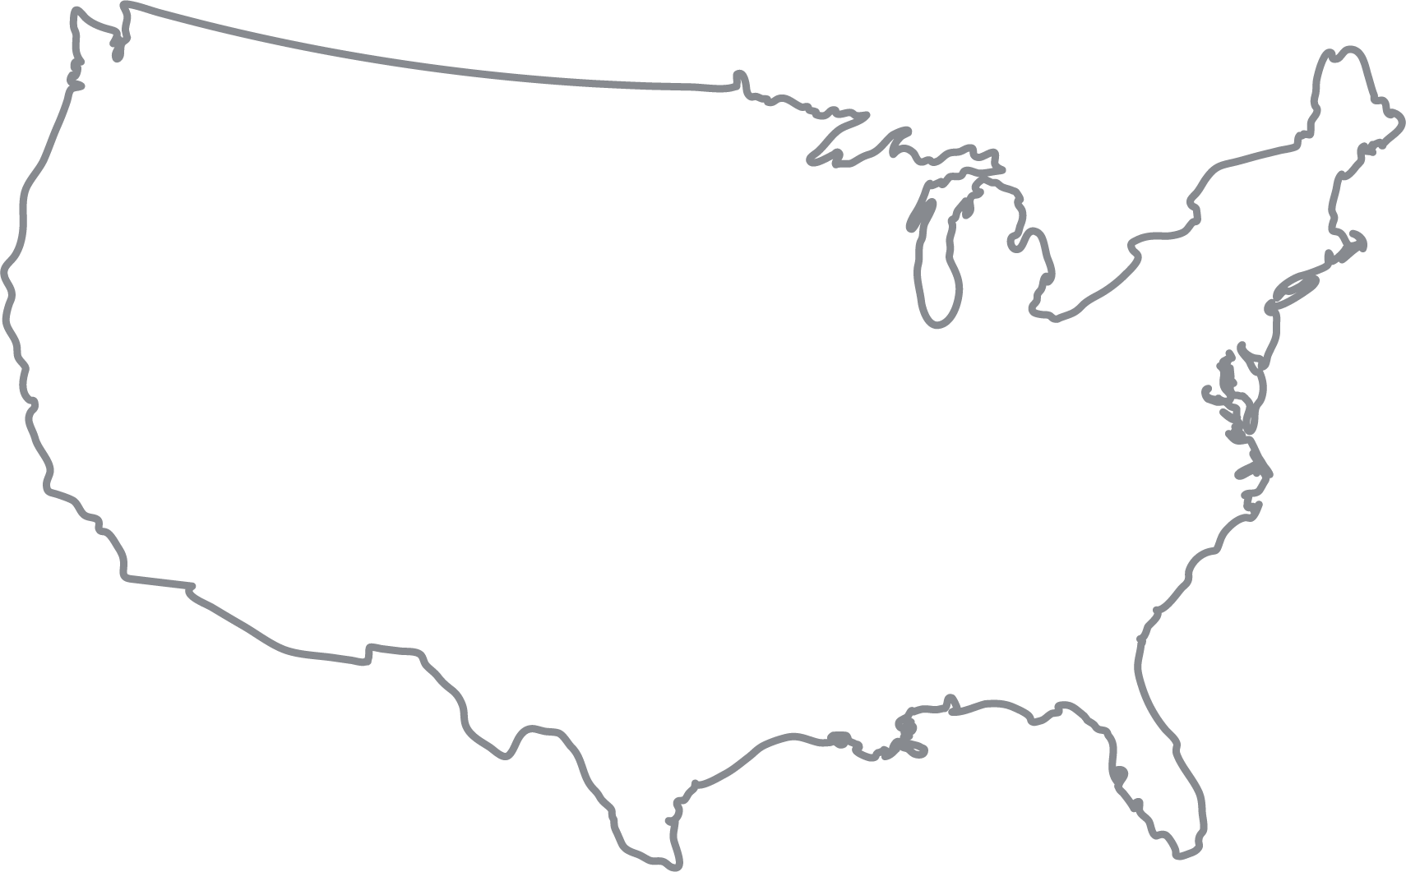
Open Access network
Get the most choices of doctors and clinics.
You’re here
healthpartners.com/openaccess
Notes:
The open access network is our biggest network and the network you will be most familiar with since it is the network that is available to you currently today. The Open Access Network has access to doctors not only in Minnesotat and the surrounding states but also access to doctors and clinics throughout the country. We are able to provide nationwide coverage through our partnership with CIGNA. You will notice their logo is listed on the back of your card. If you are traveling or on vacation throughout the country, you can refer to the logo on yoru card when accessing those providers. To find in-network doctors in our open access network, log onto your HealthPartners web account or visit healthpartners.com/openaccess today

Slide 3
Perform network
Get the most choices of doctors and clinics.
You’re here
healthpartners.com/perform
Notes:
The perform network is our second biggest network after our Open Access network. The only difference betwenn the open access network and the perform network is that the Mayo Clinic is not in-network with this network. Therefore, if you do see a doctor at Mayo clinic, your out-of-network benefits will apply with this network. You still have access to providers throughout the country with our partnership with CIGNA but again, you will not have access to Mayo Clinic with this network. To find out more, visit healthpartners.com/perform

Slide 4
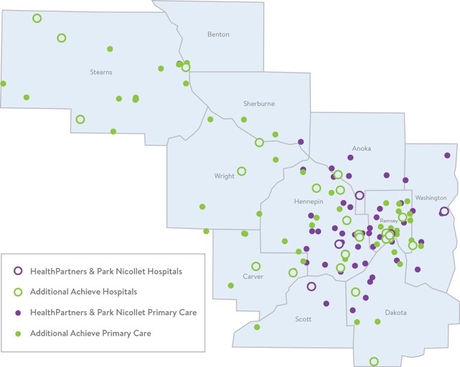

Achieve network
Higher quality care at a lower cost.
healthpartners.com/achieve
Notes:
The third network option is the Achieve network which is available to groups in the following counties:
Anoka, Benton, Carver, Chisago, Dakota, Hennepin, Isanti, McLeod, Ramsey, Scott, Sherburne, Stearns Washington and Wright counties
At HealthPartners, with this network, we do the work to find the best local doctors at the lowest cost so you can achieve better health and a fuller wallet.
Our achieve network is a focused network that mainly includes HealthPartners, Park Nicollet, Centracare providers with some additional independent doctors, clinics and hospitals.
With the achieve network you will find:
Higher quality and lower cost care
We review patient surveys, claims info and overall health care data. The doctors in the Achieve network consistently have happier, healthier patients at a lower overall cost.
You will also find that you can Choose your favorite doctor
You can see any doctor in the Achieve network. If you need additional care, your primary care doctor can help you find a specialist. Or you can pick one from the network on your own – no referral needed.
For more information you can search for your doctor or find a new one at healthpartners.com/achieve.

Slide 5
Smart Plan’s – High Value Network
Notes:
Next, lets talk about the High Value Network that is apart of the Smart Plans Sourcewell. Please note that the High Value Network is only available on the Smart Plans in the open access network and the perform network.

Slide 6

Save on surgery
Top Value locations provide the highest quality care at the best possible price.
Use a top-value facility
0% coinsurance
Go to an in-network facility
20% coinsurance
Log on to healthpartners.com to find a facility. Look for the trophy symbol.
Notes:
If you need surgery, save money by choosing a Top Value location. Top Value locations provide the highest quality care at the best possible price.
What ‘Top Value’ means
Hospitals and clinics earn a Top Value label for how well they treat conditions, including how long it takes to get better and what kinds of complications might show up later. Top Value locations are also rated highly by patients.
Your plan pays more on Smart Plans 2, 4 and 6
Your health plan will pay a higher percentage of costs when you go to a Top Value location for certain surgeries. If you are on Smart Plans 1, 3, 5 and 7, you can still save money for the plan by going to a Top Value provider. You will be reimbursed for your travel costs up to $150 for lodging per day, up to $1500 per year as long as you travel more than 50 miles per home. This also applies on smart plans 2, 4 and 6.
How does this actually work?
On Smart plans 2, 4 and 6, your plan covers 80 percent of your care costs after you hit your deductible. You pay the other 20 percent. But when you go to a Top Value facility, your plan pays for more of your surgery. Instead of paying 20 percent, you only pay five percent of the bill.
Find a Top Value facility
To find a Top Value location, log on to healthpartners.com and search by procedure. Look for a trophy symbol.

Slide 7
How a Top Value facility compares
 | At a Top Value facility | At a different facility
Cost of a knee replacement | $26,500 | $35,000
Your coinsurance amount | 0% | 20%
What you pay | $2,800 deductible | $2,800 deductible + $2,000 coinsurance (OOP max)
Your total cost | $2,800 | $4,800
Your savings | $2,000 | $0
Notes:
Let’s see how this works with an example of a knee replacement if you enrolled on Smart Plan 4.
Looking at the Top Value Facility column

Slide 8
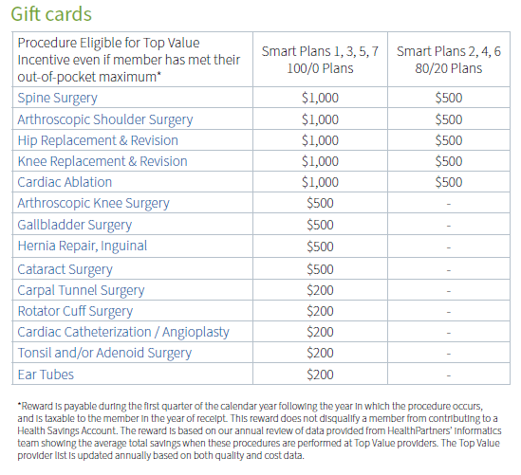
Top Value Reward Program
Notes:
The last item I want to talk about is the Top Value Reward program. As a sourcewell member you are eligible to participate in this program and be eligible to receive a gift card if you meet the requirements of the program.
We recognize that if you meet your out of pocket in a calendar year, that there isn’t as much incentive to continue to use Top Value providers. That is why, Sourcewell is offering a gift card reward for members on the smart plans who, after meeting their out-of-pocket, Continue to use Top value providers.
So what does this look like?
Well, lets say you have a knee replacement surgery scheduled in a calendar year and you end up meeting your out-of-pocket. Then, you also have to have a spine surgery in that same year. If you use a top value provider for your spine surgery and you previously used one for your knee replacement, you will earn a gift card of $1000 if you are on smart plans 1, 3, 5 and 7. if you are on smart plans 2, 4 and 6, you will receive a gift card of $500 after that calendar year has finished.
Our intent is to continue to not only save money for you as member but also for the pool with the goal of lower premiums for all in the future.

Slide 9
Thanks!
healthpartners.com
Notes:
Thank you for your time today. Please contact HealthPartners Member Services if you have any additional questions. Have a great day!

